Slide 1

CPRG 307 Slides are part of the Instructor Resources for the course required textbook and are provided with permission from the publisher:
Oracle 11g: PL/SQL Programming
Joan Casteel
978-1-133-94736-3
Course Technology (Cengage Learning)
Oracle11g:
PL/SQL Programming
Chapter 2
Basic PL/SQL
Block Structures

Slide 2
Decision Structures
Control which statements in a PL/SQL block will execute
Enables conditions to be tested to determine the flow of statement execution
Most programming languages provide IF and CASE statements to enable conditional processing
Oracle11g: PL/SQL Programming

Slide 3
Decision Structures (continued)
IF Statements
  Simple IF
  IF/THEN/ELSE
  IF/THEN/ELSIF/ELSE
CASE Statements
  Basic CASE statement
  Searched CASE statement
  CASE expression
Oracle11g: PL/SQL Programming

Slide 4
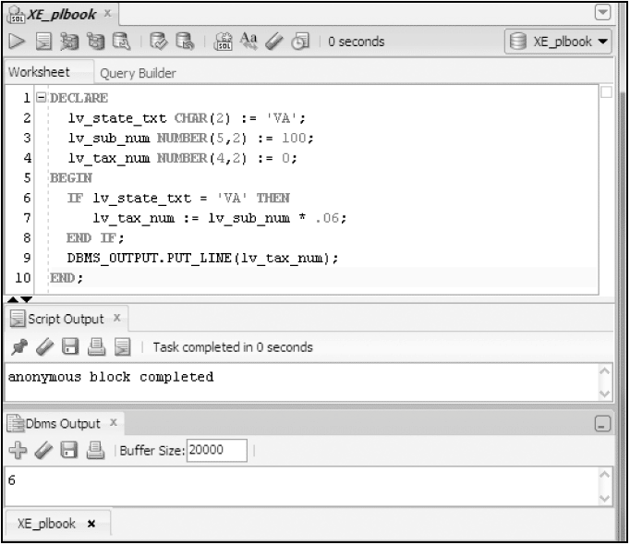
Simple IF Statement
Oracle11g: PL/SQL Programming

Slide 5
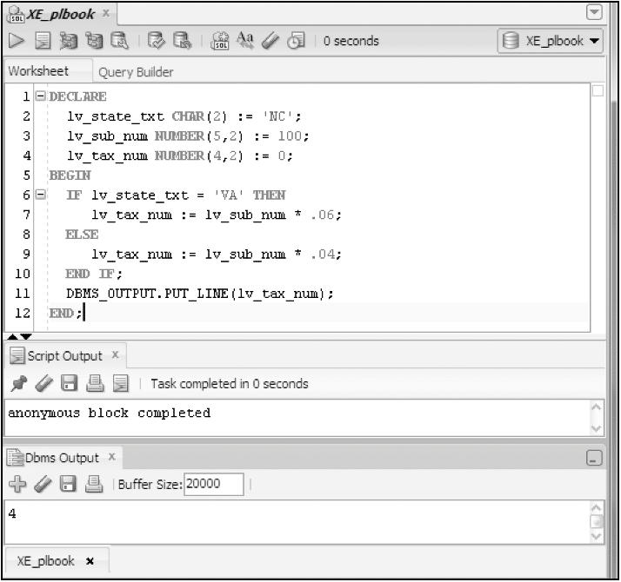
IF/THEN/ELSE
Oracle11g: PL/SQL Programming

Slide 6
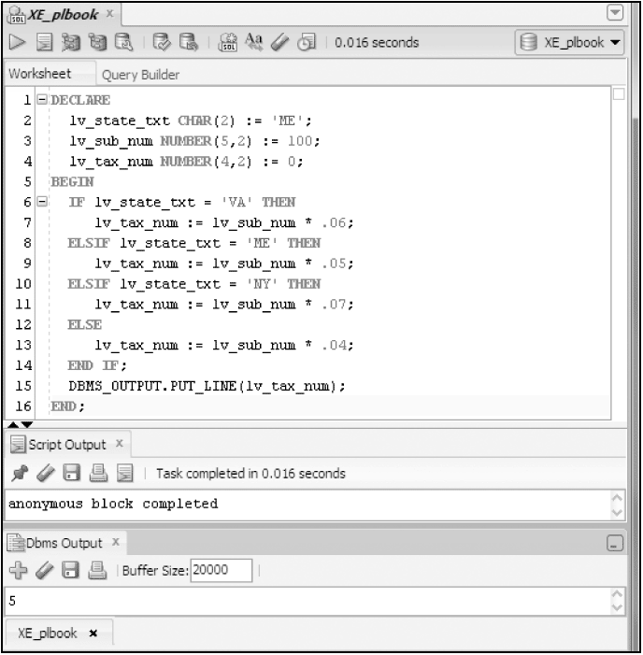
IF/THEN/ELSIF/ELSE
Oracle11g: PL/SQL Programming

Slide 7
Nested IF
IF lv_type_txt = 'E' THEN
IF lv_price_num > 85 THEN <-- Inner or nested IF begins
lv_disc_num = .20;
ELSIF lv_price_num > 45 THEN
lv_disc_num = .15;
ELSE
lv_disc_num = .10;
END IF; <-- Inner or nested IF ends
ELSIF lv_type_txt = 'C' THEN
lv_disc_num = .05;
END IF;
Oracle11g: PL/SQL Programming

Slide 8
Logical Operators within IF
Logical operators (AND, OR) enable multiple conditions to be checked
IF lv_state_txt = 'VA' OR lv_state_txt = 'PA' THEN
lv_tax_num := lv_sub_num * .06;
ELSE
lv_tax_num := lv_sub_num * .04;
END IF;
Oracle11g: PL/SQL Programming

Slide 9
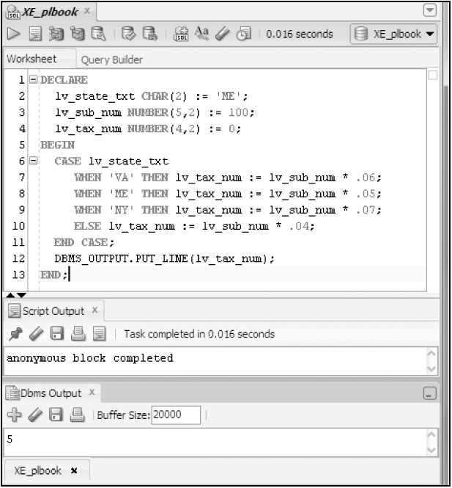
Basic CASE Statement
Oracle11g: PL/SQL Programming

Slide 10
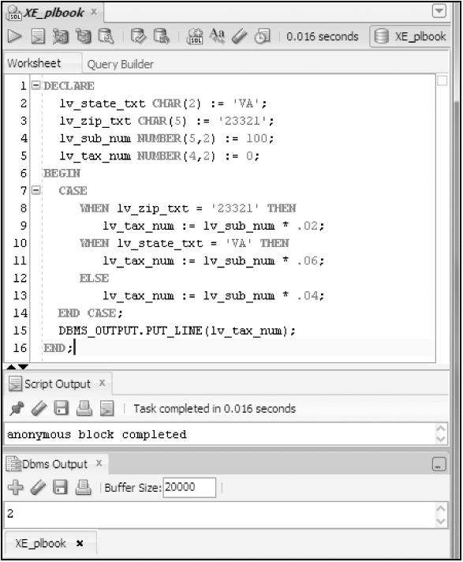
Searched CASE
Oracle11g: PL/SQL Programming

Slide 11
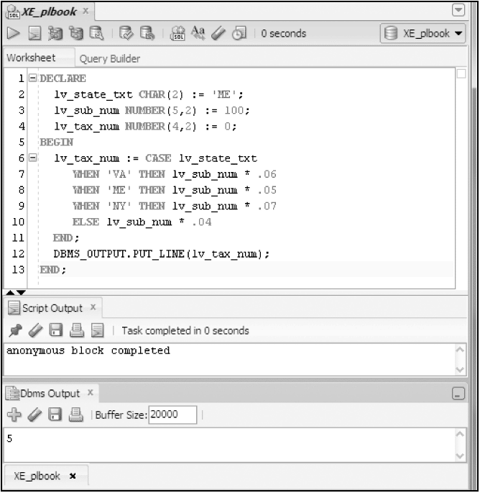
CASE Expression
Oracle11g: PL/SQL Programming

Slide 12
Looping
Enables a statement or set of statements to be executed more than once
A loop must provide instructions of when to end the looping, or an ‘infinite’ loop will be produced
Oracle11g: PL/SQL Programming

Slide 13
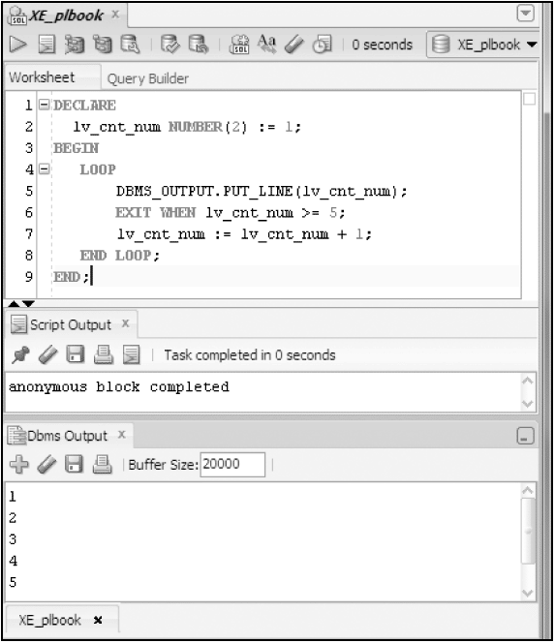
Basic LOOP
Oracle11g: PL/SQL Programming

Slide 14
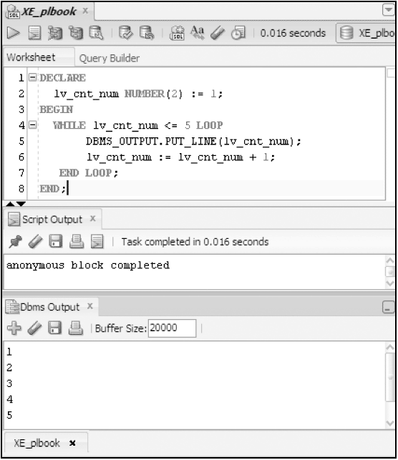
WHILE Loop
Oracle11g: PL/SQL Programming

Slide 15
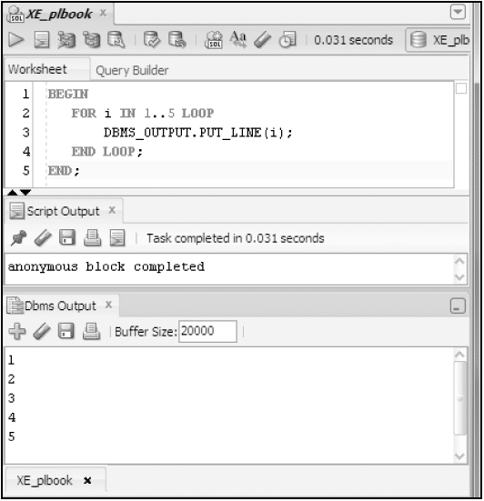
FOR Loop
Oracle11g: PL/SQL Programming

Slide 16
Looping
Starting with Oracle 11g, the program can control when the next iteration of the loop will occur.
This is done with the CONTINUE WHEN clause.
Do not use the CONTINUE WHEN outside of a loop.
Do not use the CONTINUE WHEN to interrupt the flow of a stored program.
CPRG 307

Slide 17
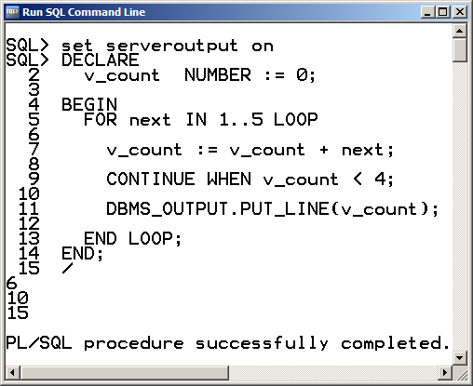
CONTINUE WHEN
CPRG 307

Slide 18
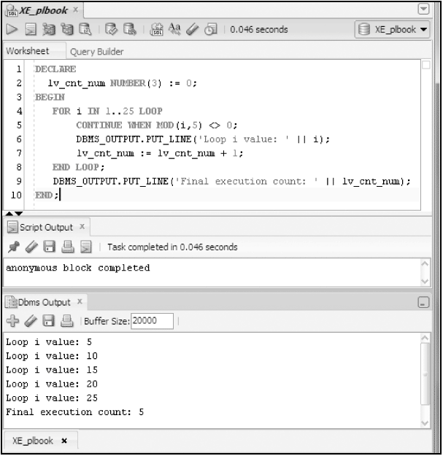
CONTINUE Statement
Oracle11g: PL/SQL Programming

Slide 19
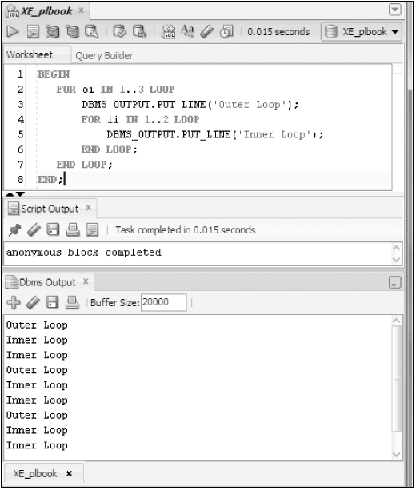
Nested Loops
Oracle11g: PL/SQL Programming

